Slide 1
H1N1 and Seasonal Flu Vaccine
Administration Data
March 24, 2021

Slide 2
Overview
The National 2009 H1N1 Flu Survey (NHFS) was sponsored by the National Center for Immunization and Respiratory Diseases (NCIRD) and conducted jointly by NCIRD and the National Center for Health Statistics (NCHS), Centers for Disease Control and Prevention (CDC). The NHFS was a list-assisted random-digit-dialing telephone survey of households, designed to monitor influenza immunization coverage in the 2009-10 season.

Slide 3
Project objective:
Predict whether a respondent will receive the H1N1 and/or seasonal flu vaccines using information they shared about their backgrounds, opinions, and health behaviors.

Slide 4
Data
Dictionary
A data dictionary for this dataset was created and can be referenced in the final project.
As this dataset contains results of a survey, the binary responses are yes/no and there are categorical response variables in which the respondents’ answers fall into a category.

Slide 5
Target Variables

Slide 6
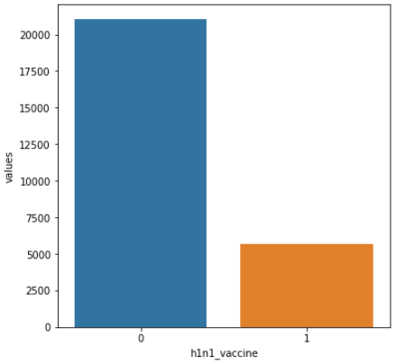
Target Variables
H1N1 (h1n1_vaccine)
There are almost four times more people who did not receive the H1N1 vaccine than those who did. We will need to rely on different metrics to gauge the fit of the models because of this.

Slide 7
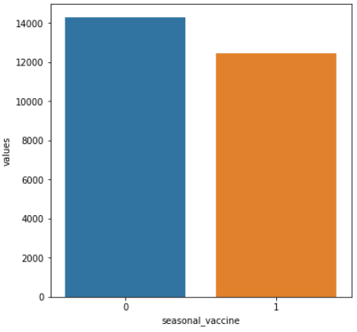
Target Variables
Seasonal Flu (seasonal_vaccine)
The number of people who received the flu shot is nearly as high as the number of people who did not. This number is much more balanced than the difference in the H1N1 vaccine recipients.

Slide 8
Exploratory Data Analysis

Slide 9
Exploratory
Data Analysis
(EDA)
Prior to modeling data for prediction, exploratory data analysis (EDA) must occur. EDA is the process in which variables and their interactions are observed and explored.

Slide 10
Feature Interactions

Slide 11
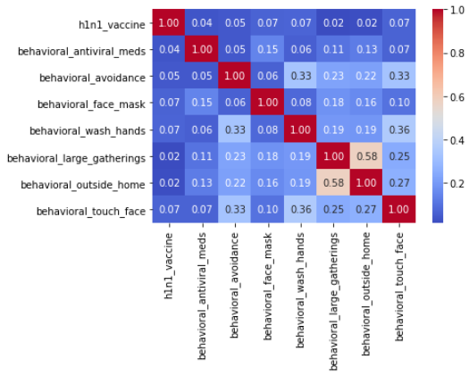
H1N1
(Behavioral)

Slide 12
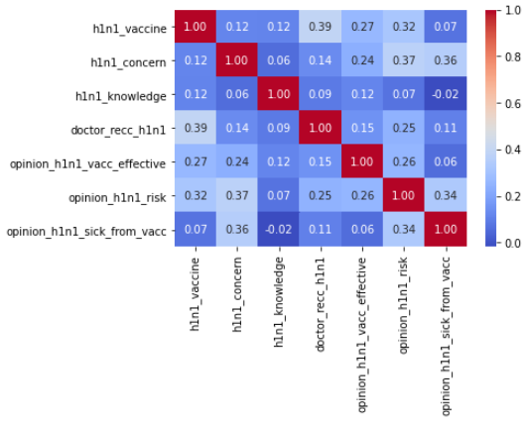
H1N1
(Opinion)

Slide 13
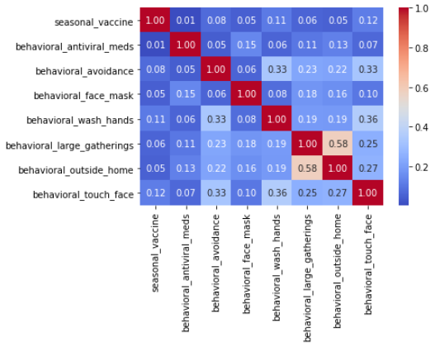
Seasonal Flu
(Behavioral)

Slide 14
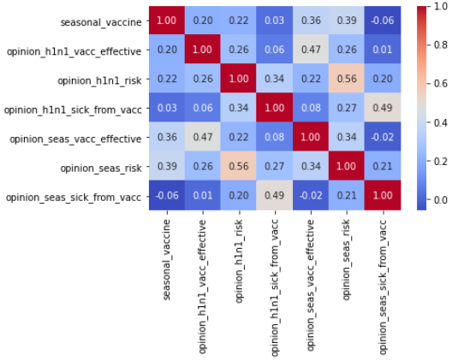
Seasonal Flu
(Opinion)

Slide 15
Feature Engineering

Slide 16
Null Values
Null values were replaced with the mode of each feature. This was ideal in our situation because there were many categorical variables. Choosing the mode selected the most common response for each feature.
'health_insurance', 'income_poverty', 'employment_industry', and 'employment_occupation' had very high numbers of missing values so I removed them from the analysis.

Slide 17
One-Hot Encoding
One-hot encoding is a type of vector representation in which all of the elements in a vector are 0, except for one, which has 1 as its value, where 1 represents a boolean specifying a category of the element.
This allowed me to utilize more features than I would have previously been able to use to make a stronger model.

Slide 18
Data Preparation

Slide 19
Training and Test Data Split
So that the model performance can be evaluated accurately, we will split our dataset into training and test datasets. The models will be trained with the training data and then evaluated by comparing the predictions for the test set to the actual results.
For this scenario, I split the dataset into 80% training and 20% test data.

Slide 20
Training and Test Data Split
Two different training and test data sets were split. I created one training and test set that identified the target variable as ‘h1n1_vaccine’ and I created one training and test set that identified the target variable as ‘seasonal_vaccine’.

Slide 21
Feature
Scaling
Feature scaling was applied to these training and test datasets. Feature scaling normalizes the data so that modeling is easily calculable and in order to standardize the range of functionality of the input dataset.

Slide 22
Feature Selection

Slide 23
Lasso (L1) Regularization
I utilized Lasso (L1-Regularization) for feature selection. This method determines the most important variables to include in analysis and zeros out the coefficients for the less important features in a way that avoids overfitting. This allows for a more robust model.
This was performed on both the H1N1 and Seasonal Flu datasets separately.

Slide 24
Modeling

Slide 25
Models Tested
Logistic Regression
K-Nearest Neighbors
Gradient Boosting Classifier
Decision Tree
Decision Tree with Tuning
Random Forest
Random Forest with Tuning
Voting Classifier Ensemble

Slide 26
Metrics
Accuracy
Precision
Recall
F1 Score
Misclassified Samples
AUC/ROC Score

Slide 27
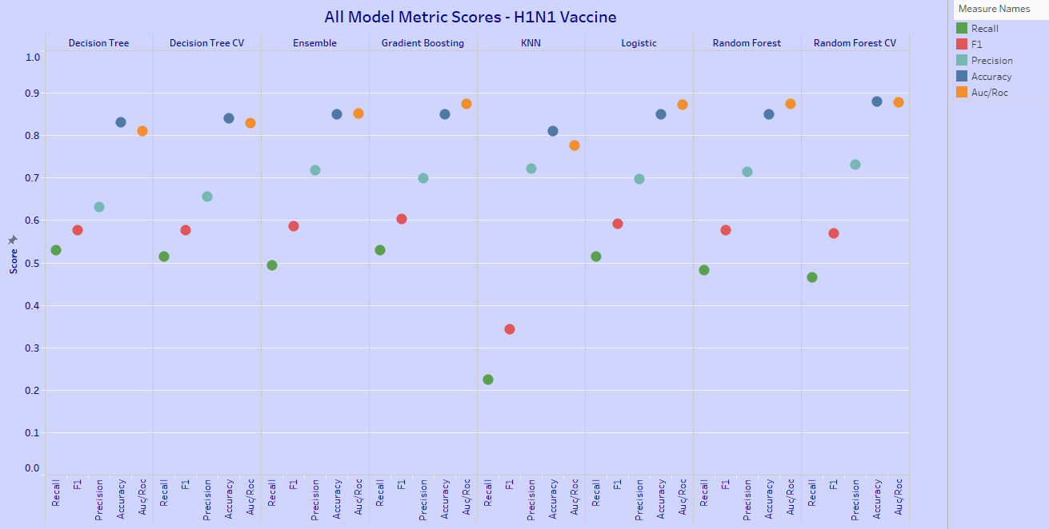
All Models & Metrics - H1N1 Vaccine

Slide 28
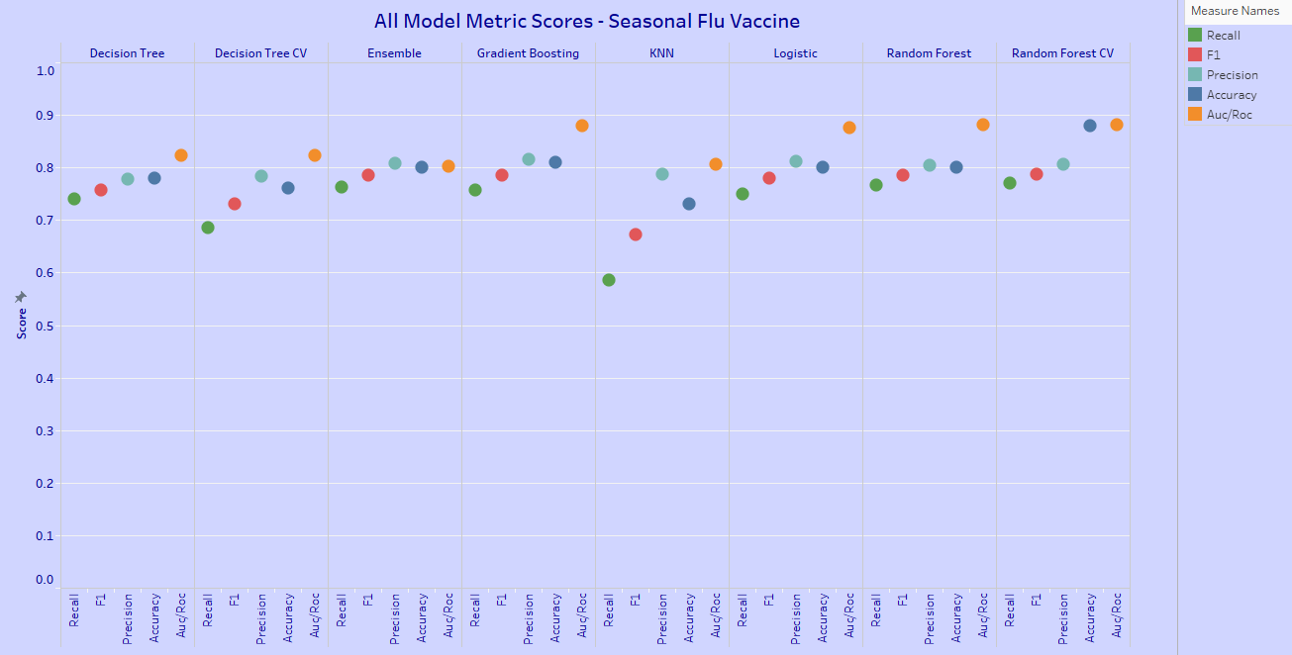
All Models & Metrics - Seasonal Flu Vaccine

Slide 29
Why use ROC/AUC to Determine the Best Model?
The ROC is plotted between true positive (1.0) and false positive (0.0) rates.
The area under the curve (AUC) is the summary of this curve that tells generally how well a model is performing.
The AUC measures the quality of the model's predictions irrespective of what classification threshold is chosen - ideal for an unbalanced problem like ours.

Slide 30
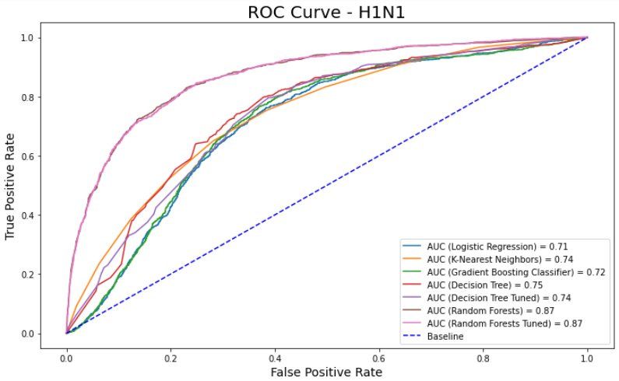

Slide 31
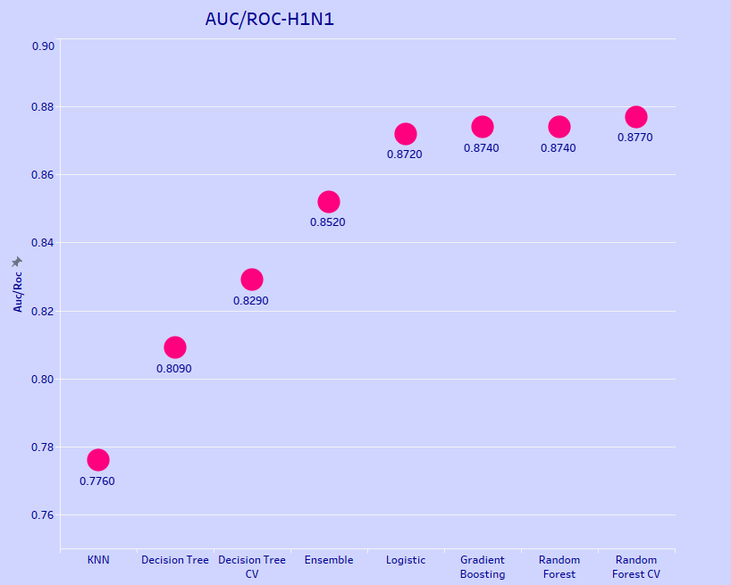

Slide 32
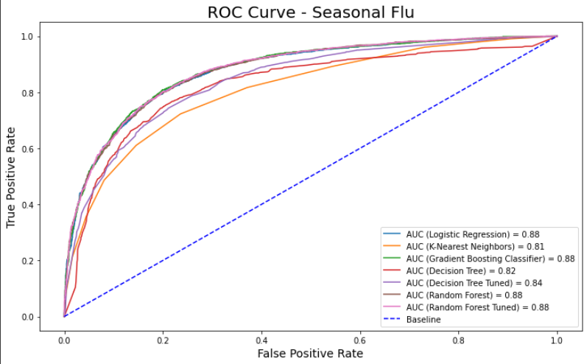

Slide 33
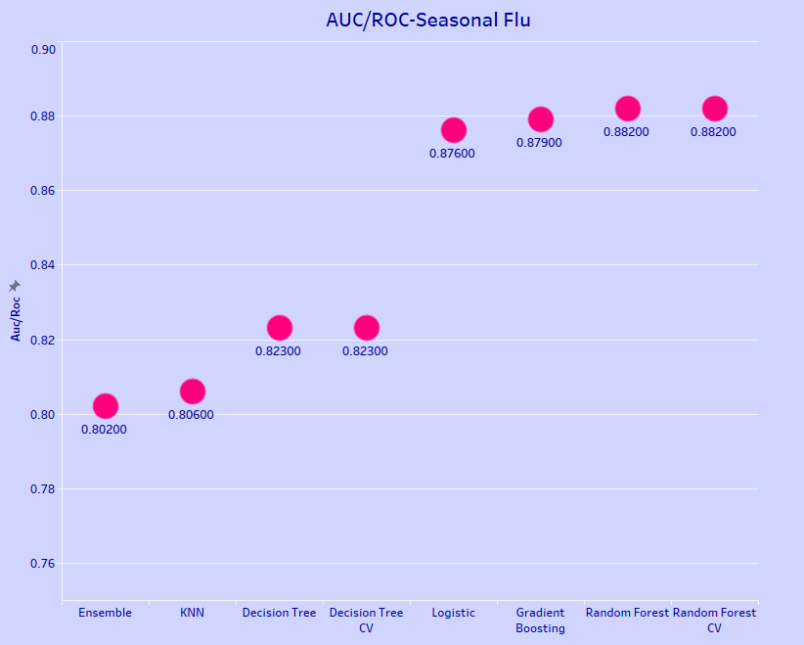

Slide 34
Proposed Models
H1N1 - Primary
Random Forest with Cross Validation
H1N1 - Secondary
Gradient Boosting Classifier
Seasonal Flu - Primary
Random Forest with Cross Validation
Seasonal Flu - Secondary
Gradient Boosting Classifier

Slide 35
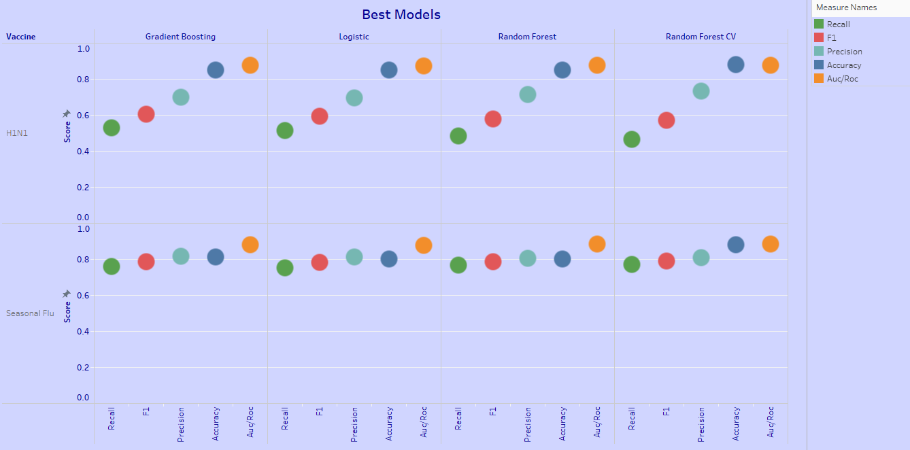

Slide 36
Questions?

